Slide 1
APP TRADER
10 apps to weather the COVID-19 Pandemic

Slide 2
Our Criteria
Crossover Titles
Free Price Tag
Rating of 4.5+ stars

Slide 3
Crossover Titles
$4,000 per month
Nearly $500,000 net lifetime profit per app
Low monthly advertisement fee

Slide 4
Free
Low upfront cost to purchase app
Investment returned in 5 months
No threshold to buys
Huge download base

Slide 5
Rating
4.5 stars and above
More stars = longer lifespan
Lifespan = more money for less

Slide 6
How we got here
Wanted to maximize profit for a long time
What was the math

Slide 7

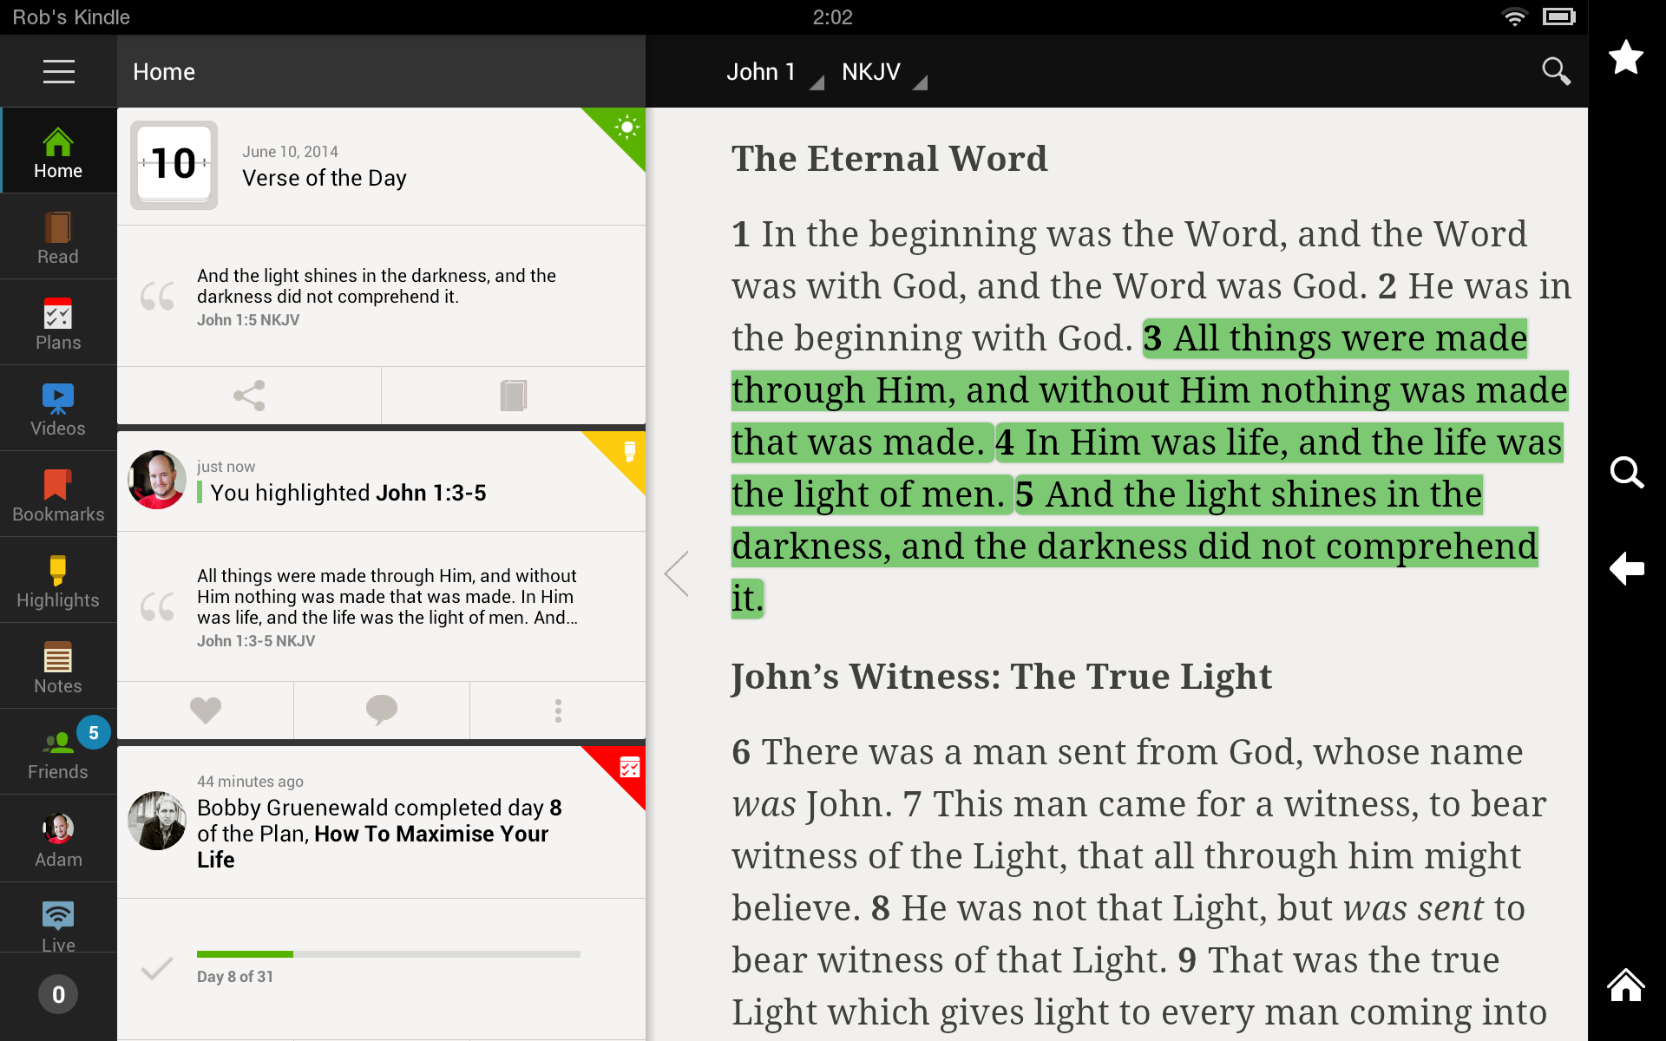
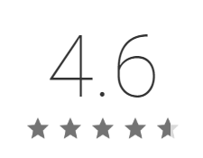
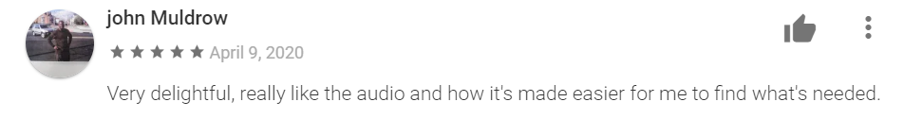
THE BIBLE

Slide 8
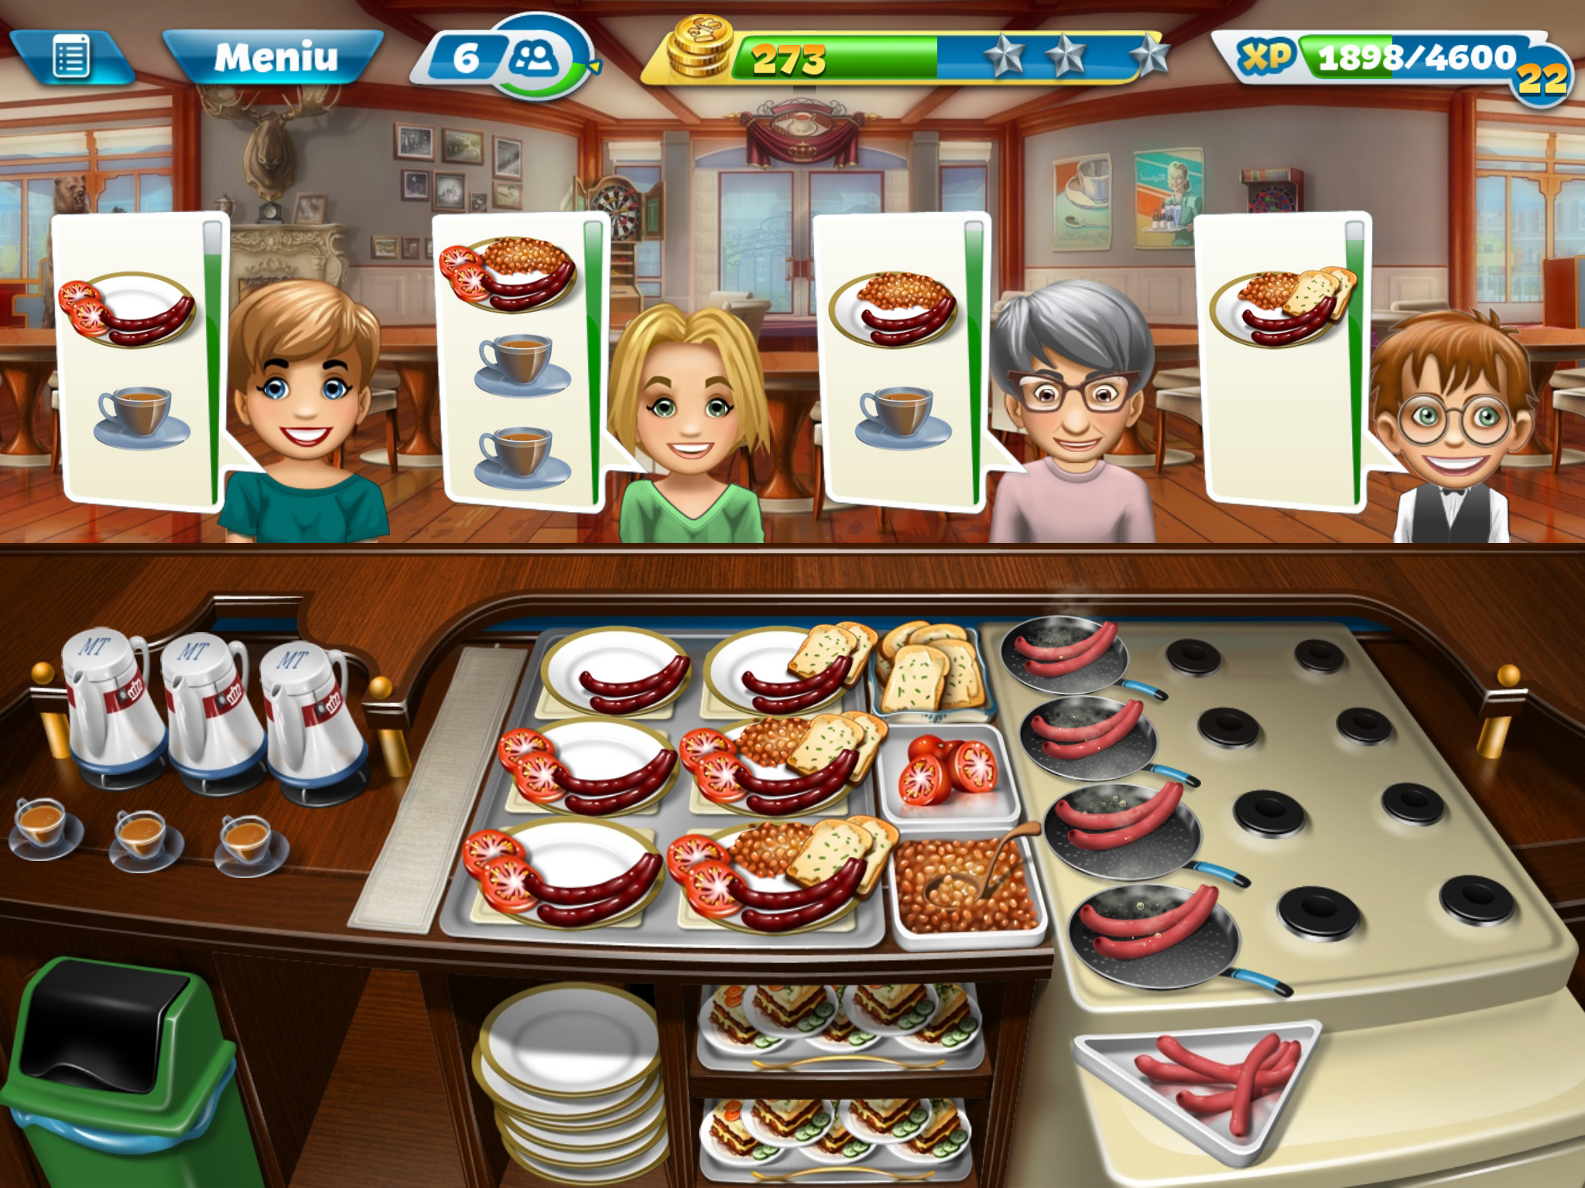
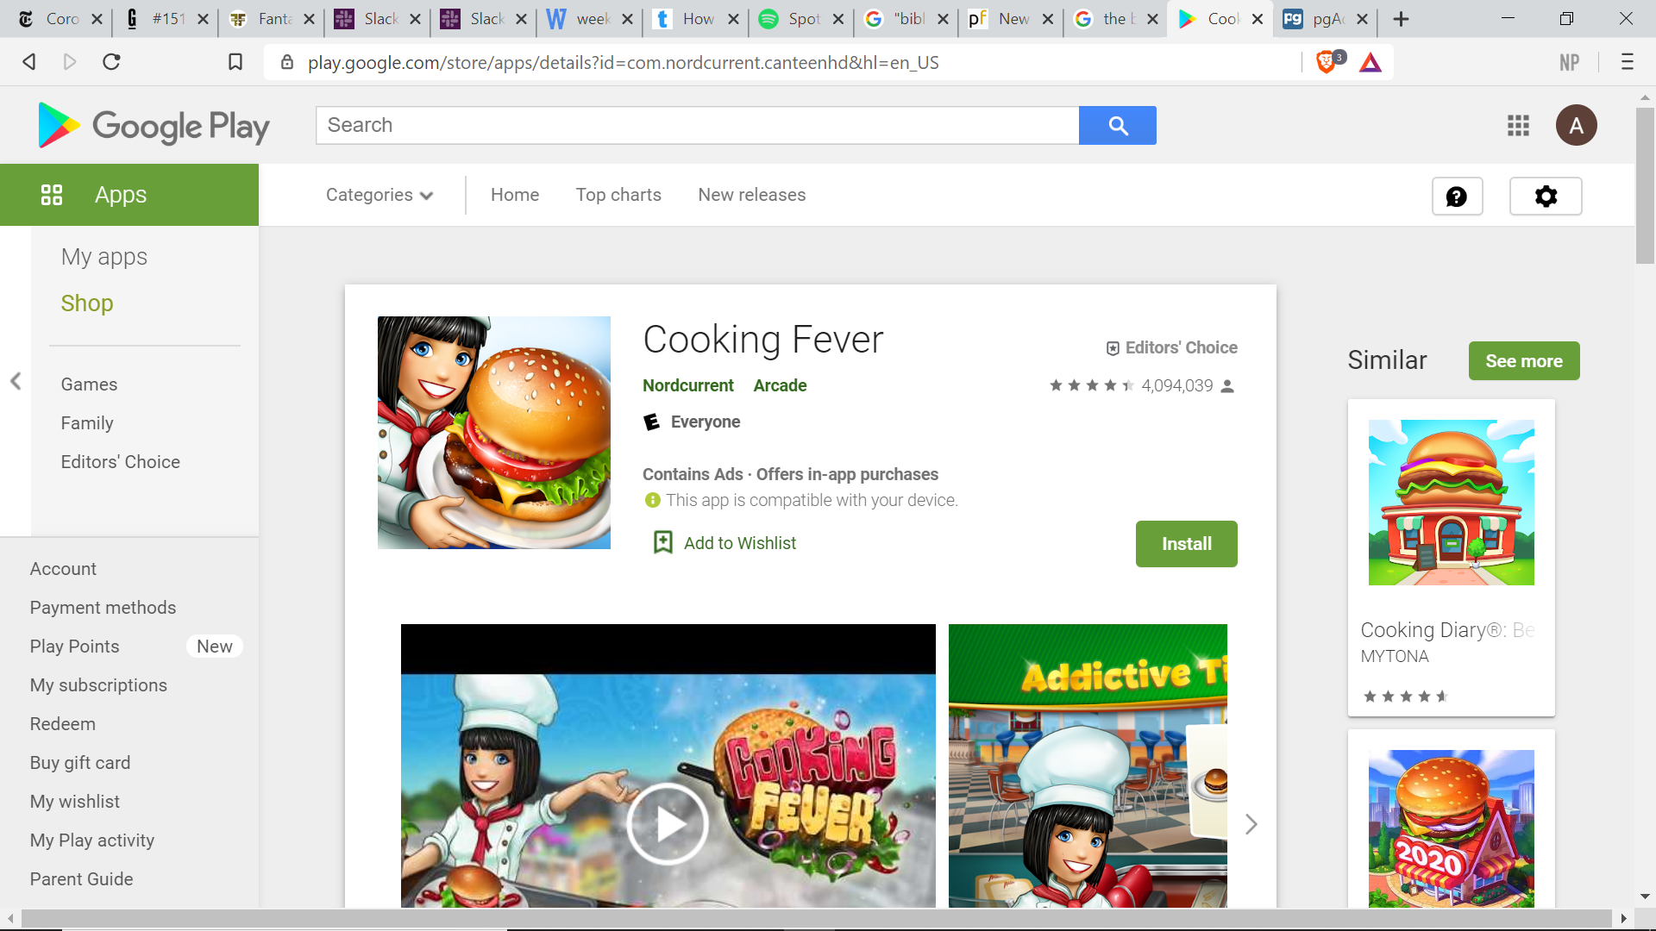
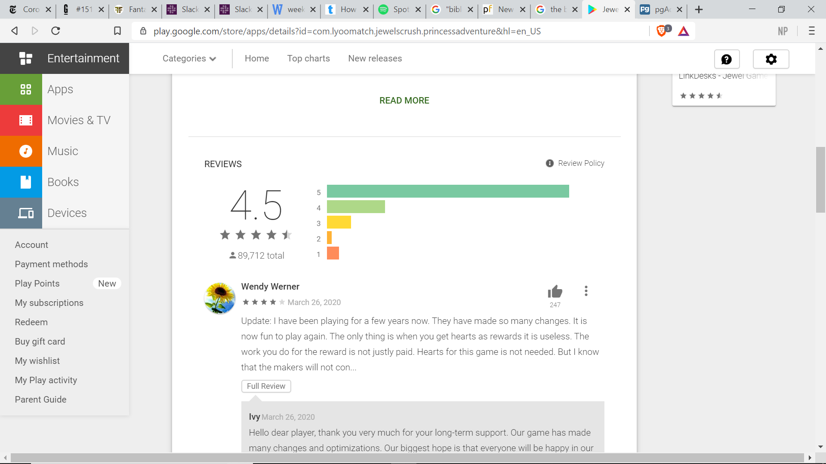
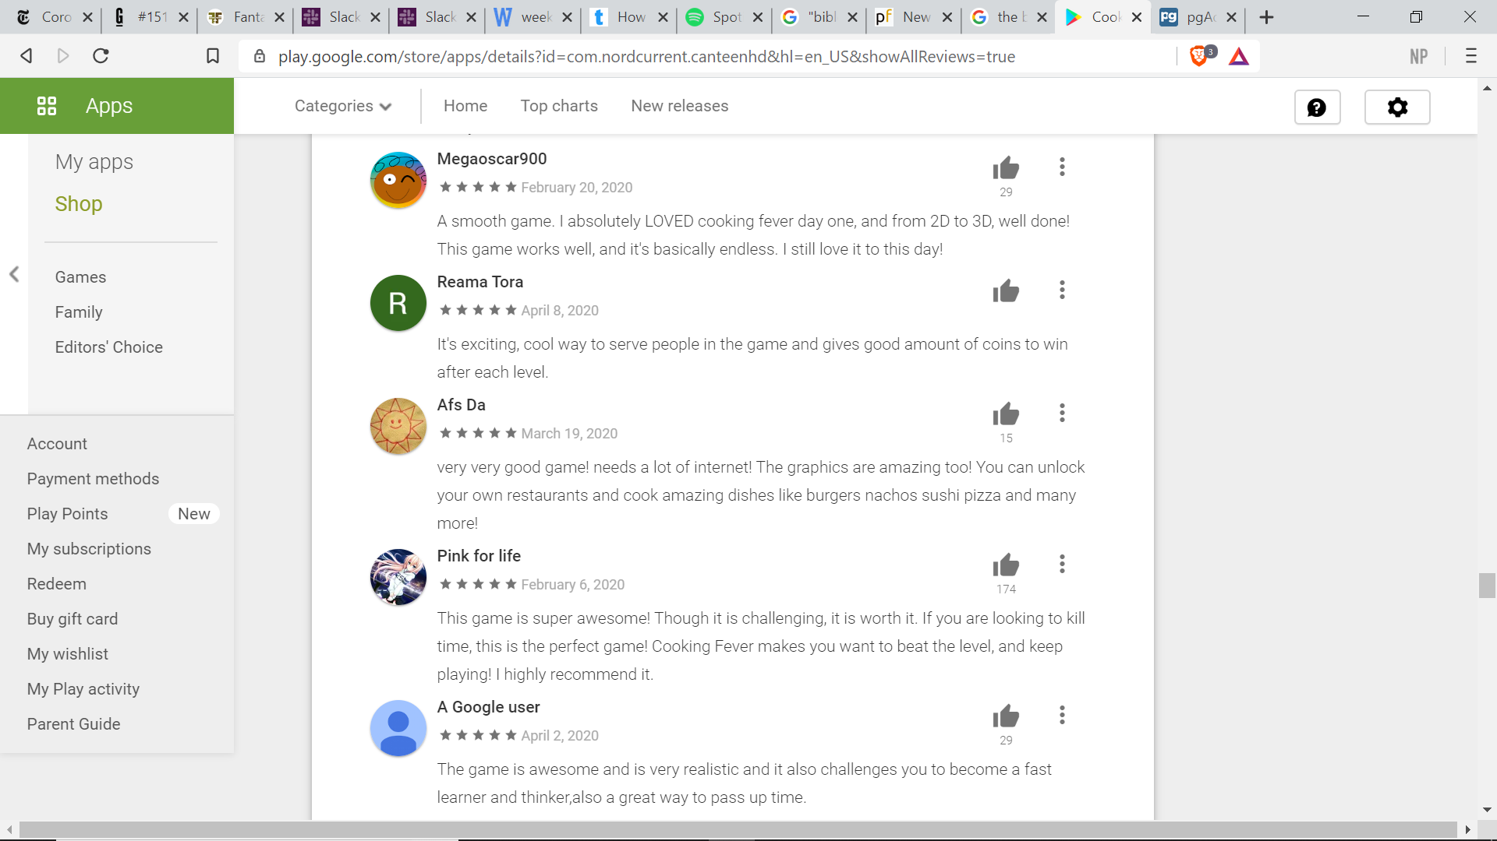
COOKING FEVER

Slide 9
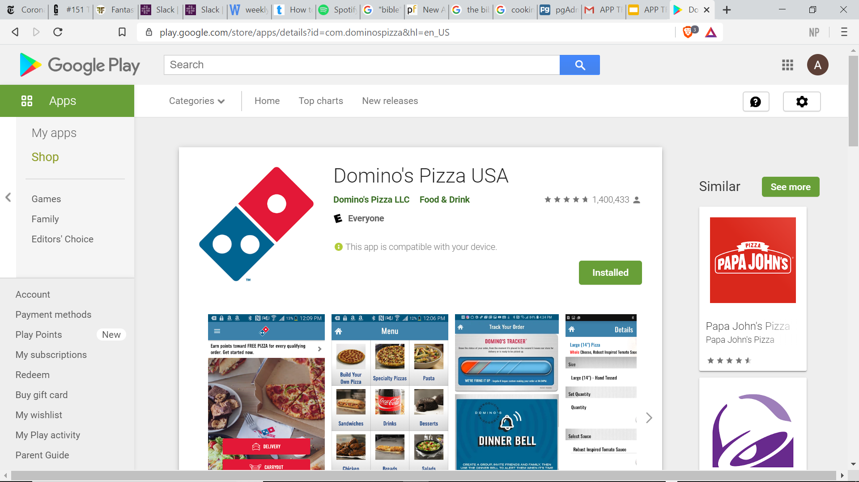
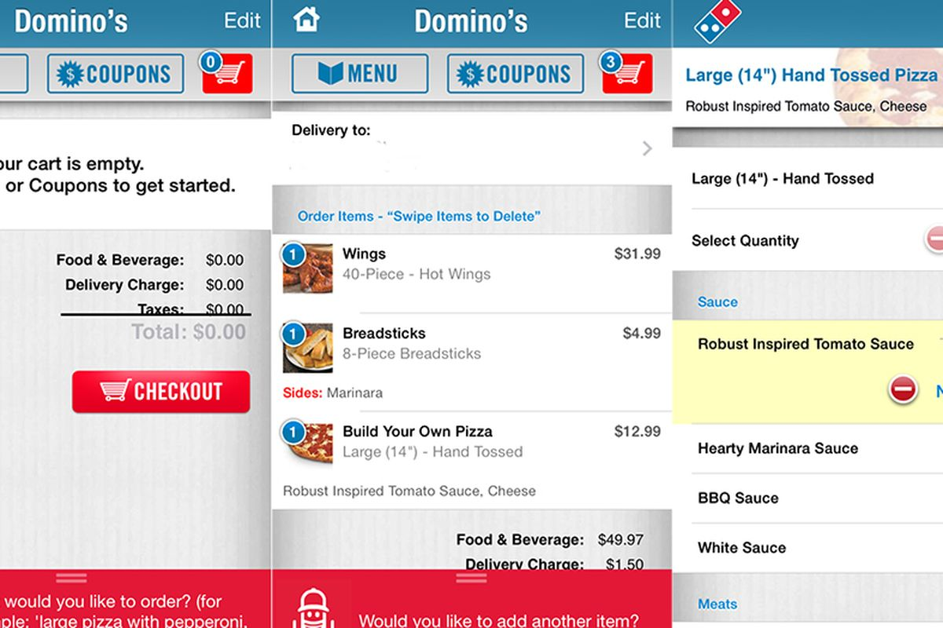
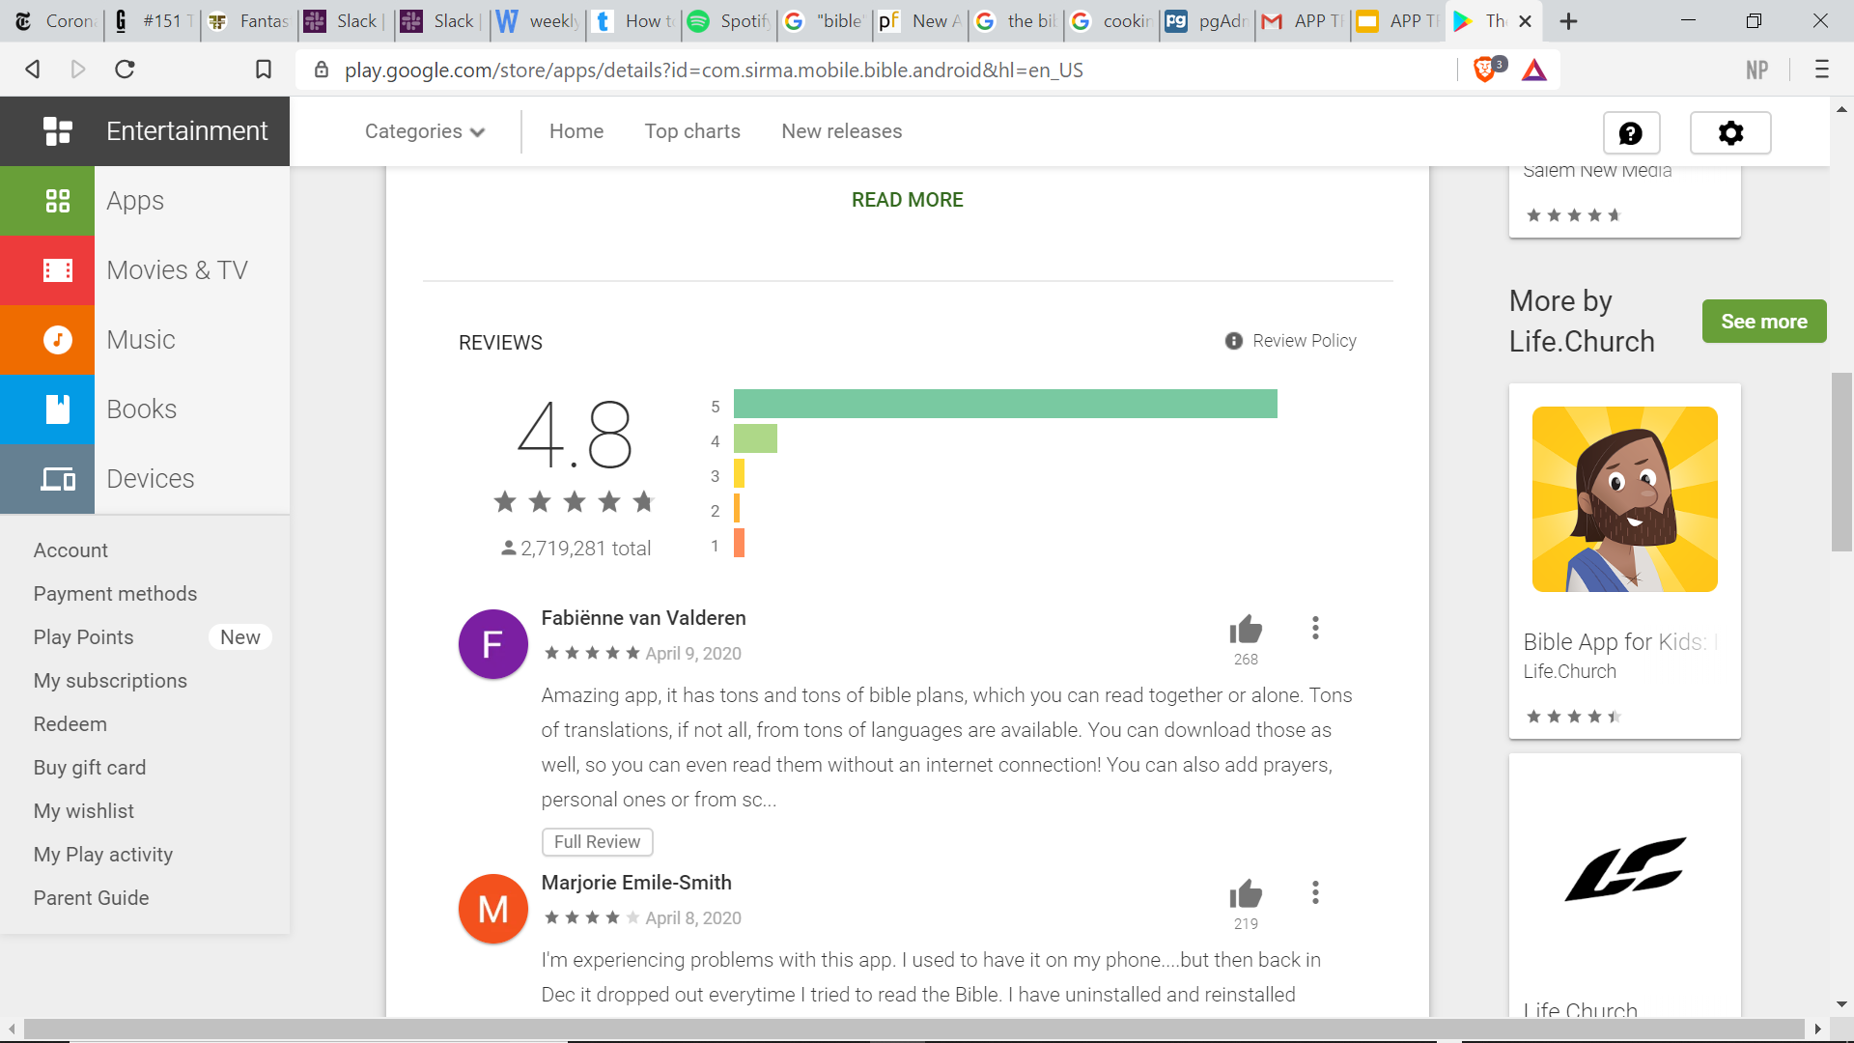
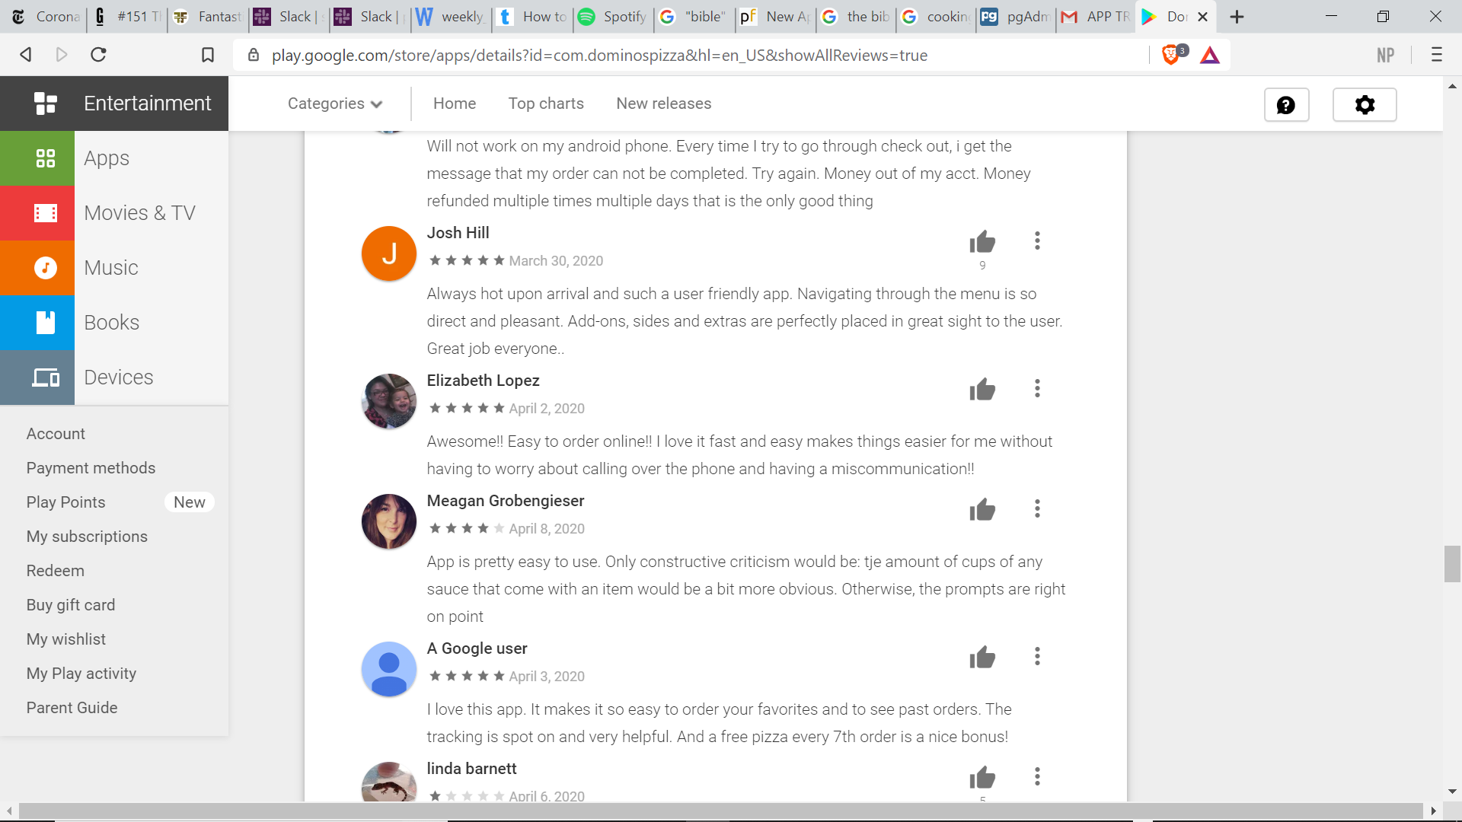
DOMINOS PIZZA

Slide 10
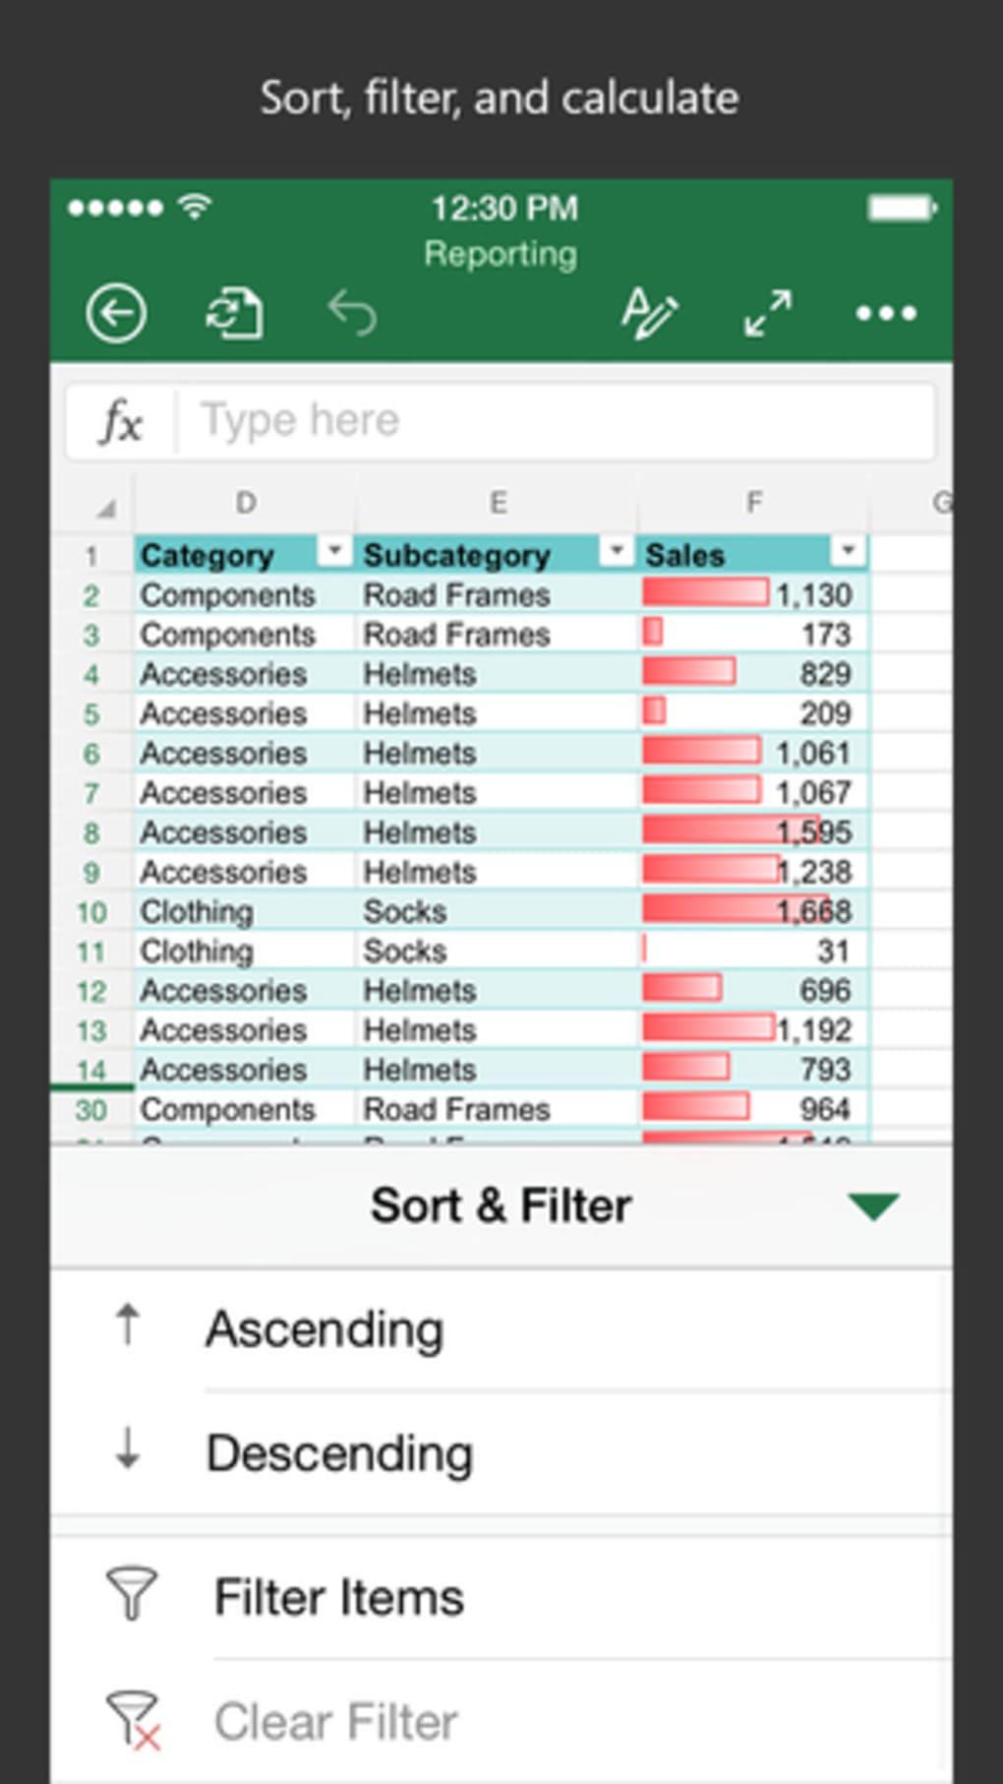
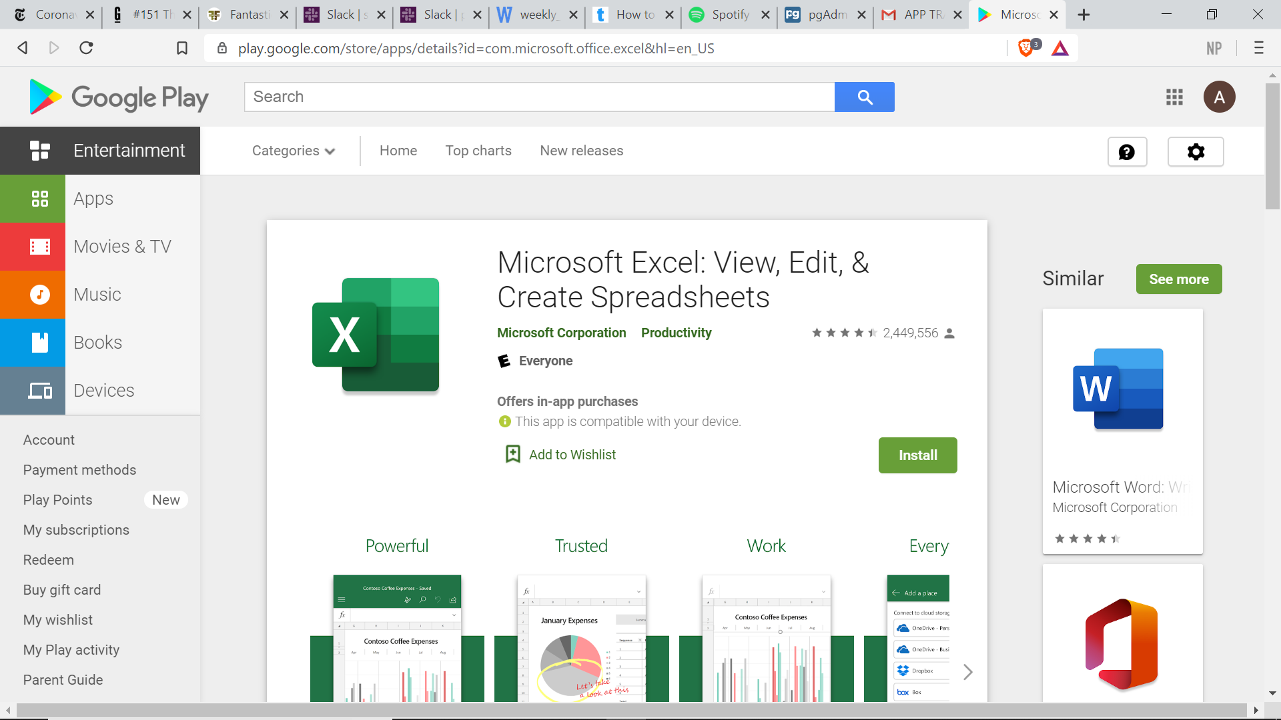
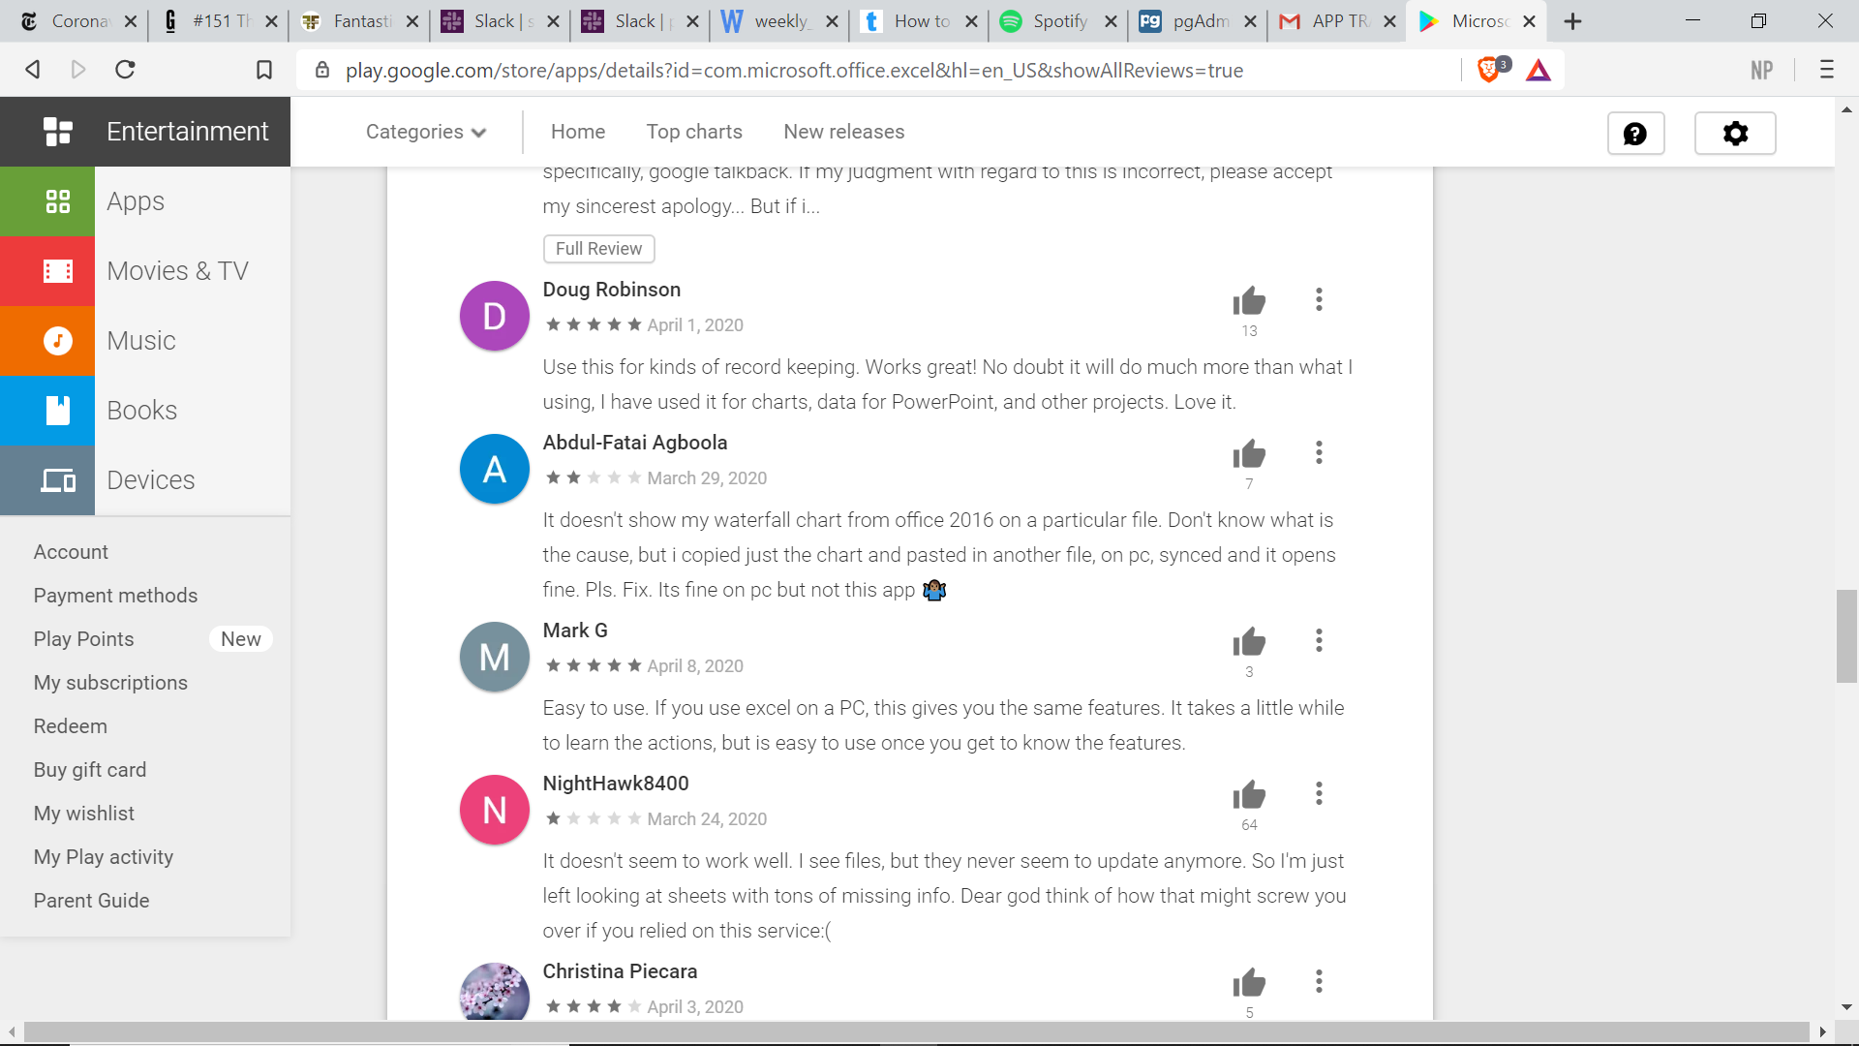
MICROSOFT EXCEL

Slide 11

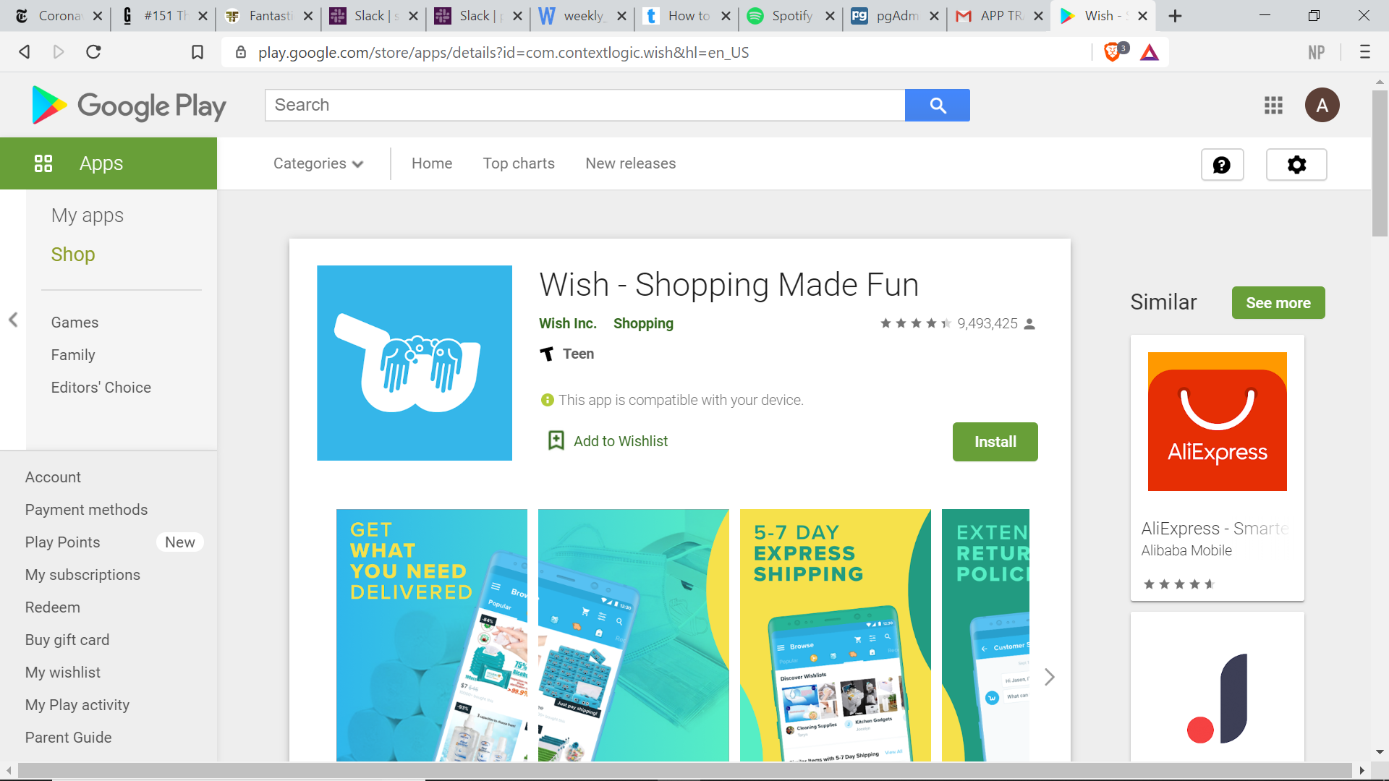
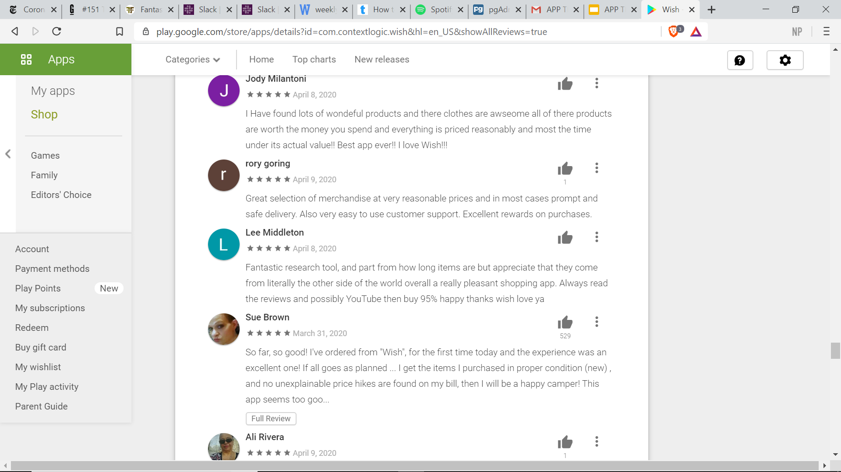
WISH

Slide 12
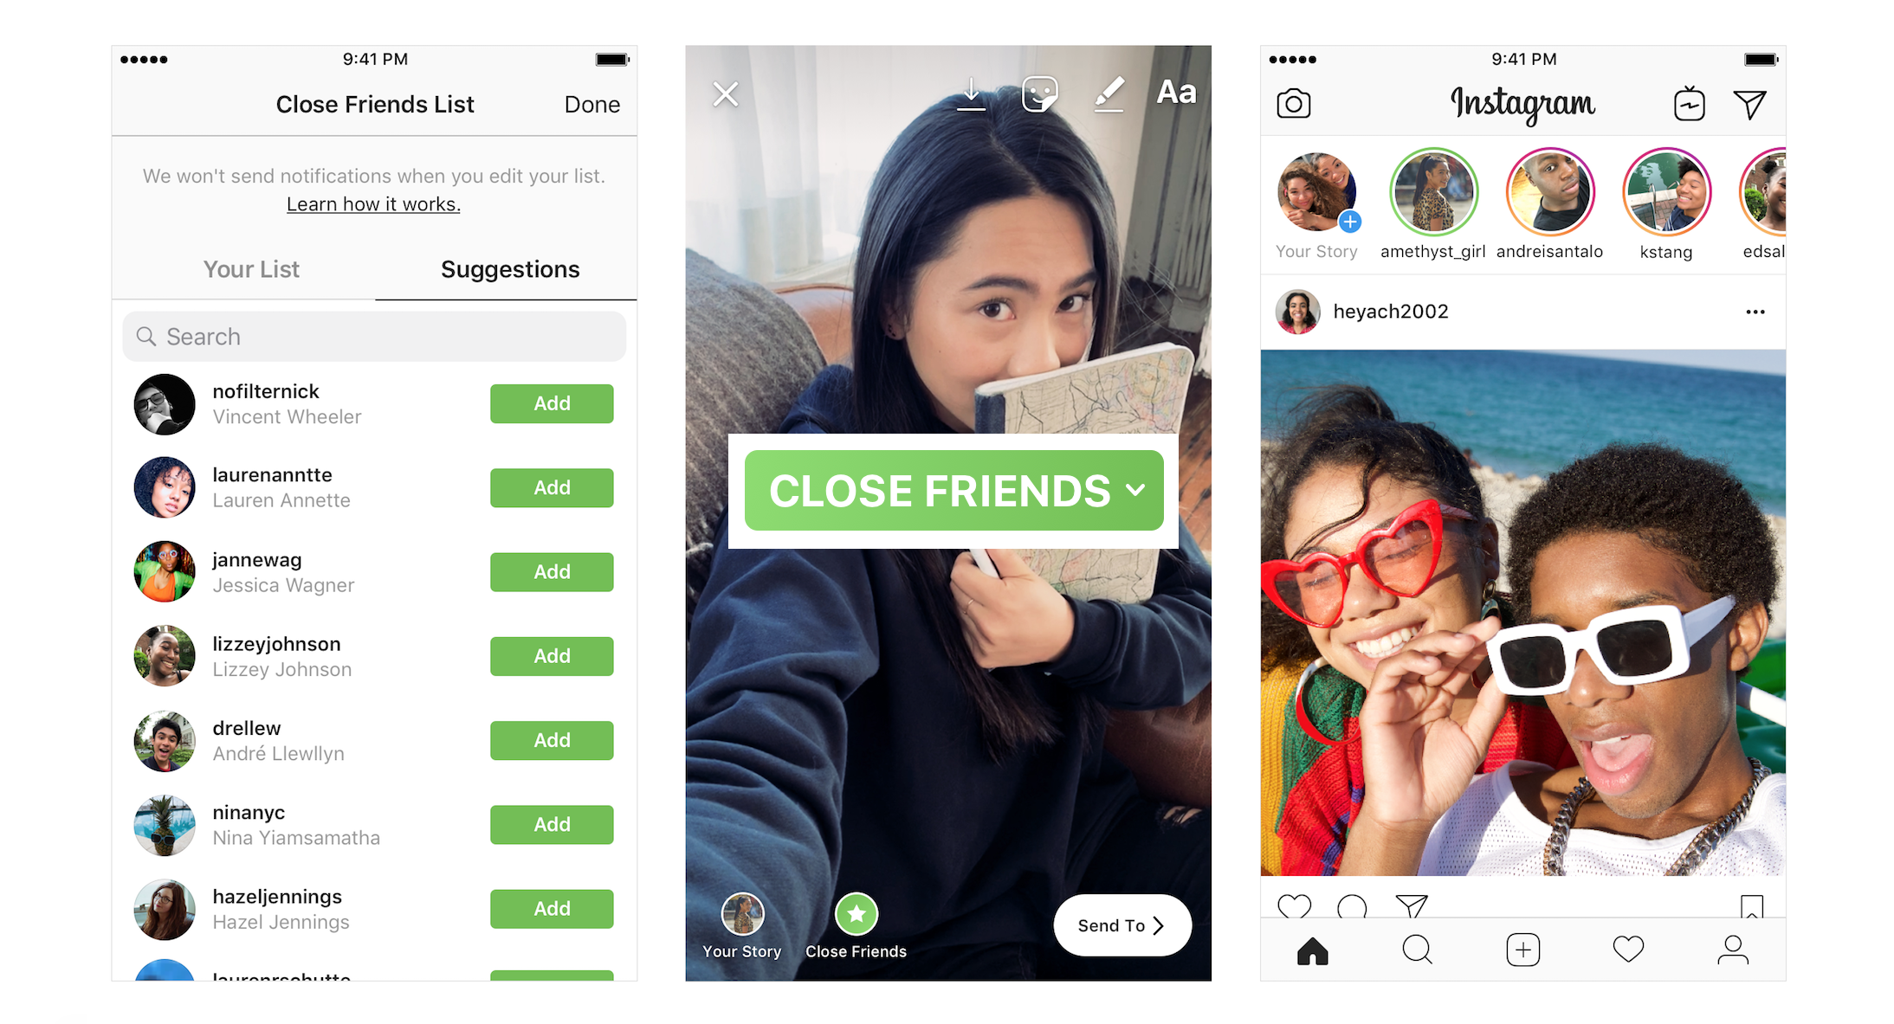
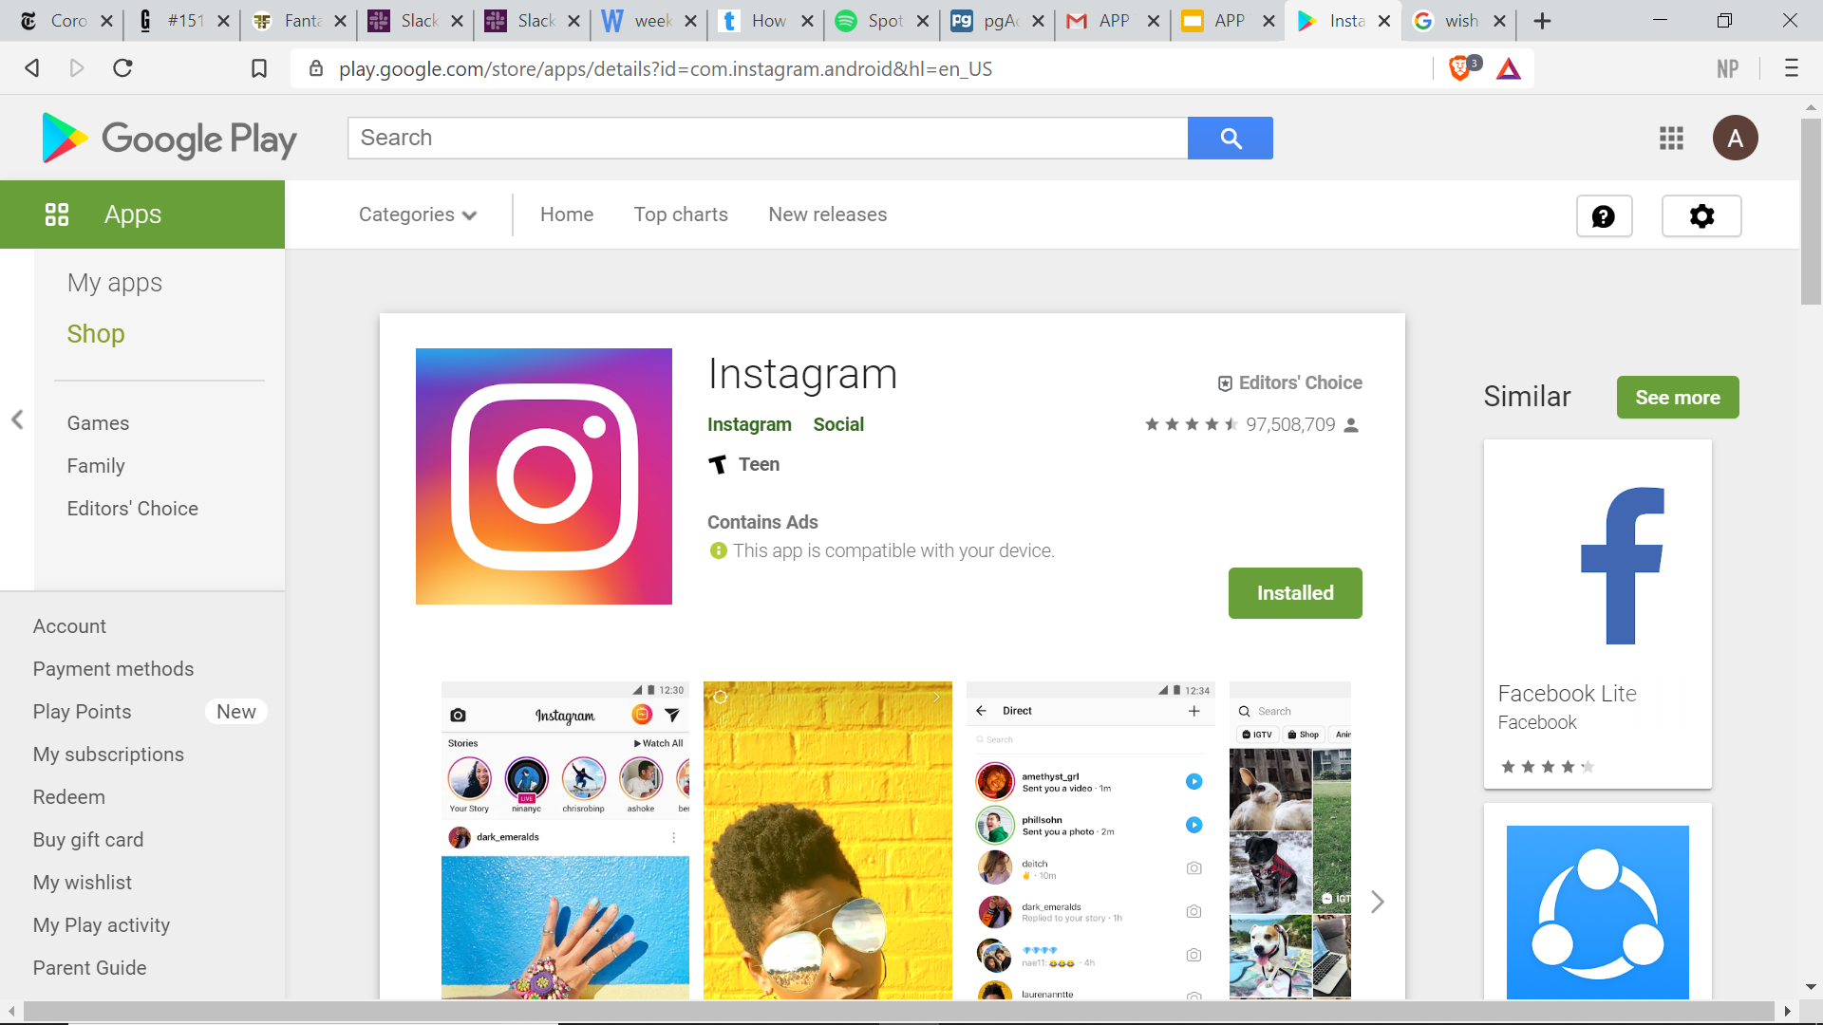
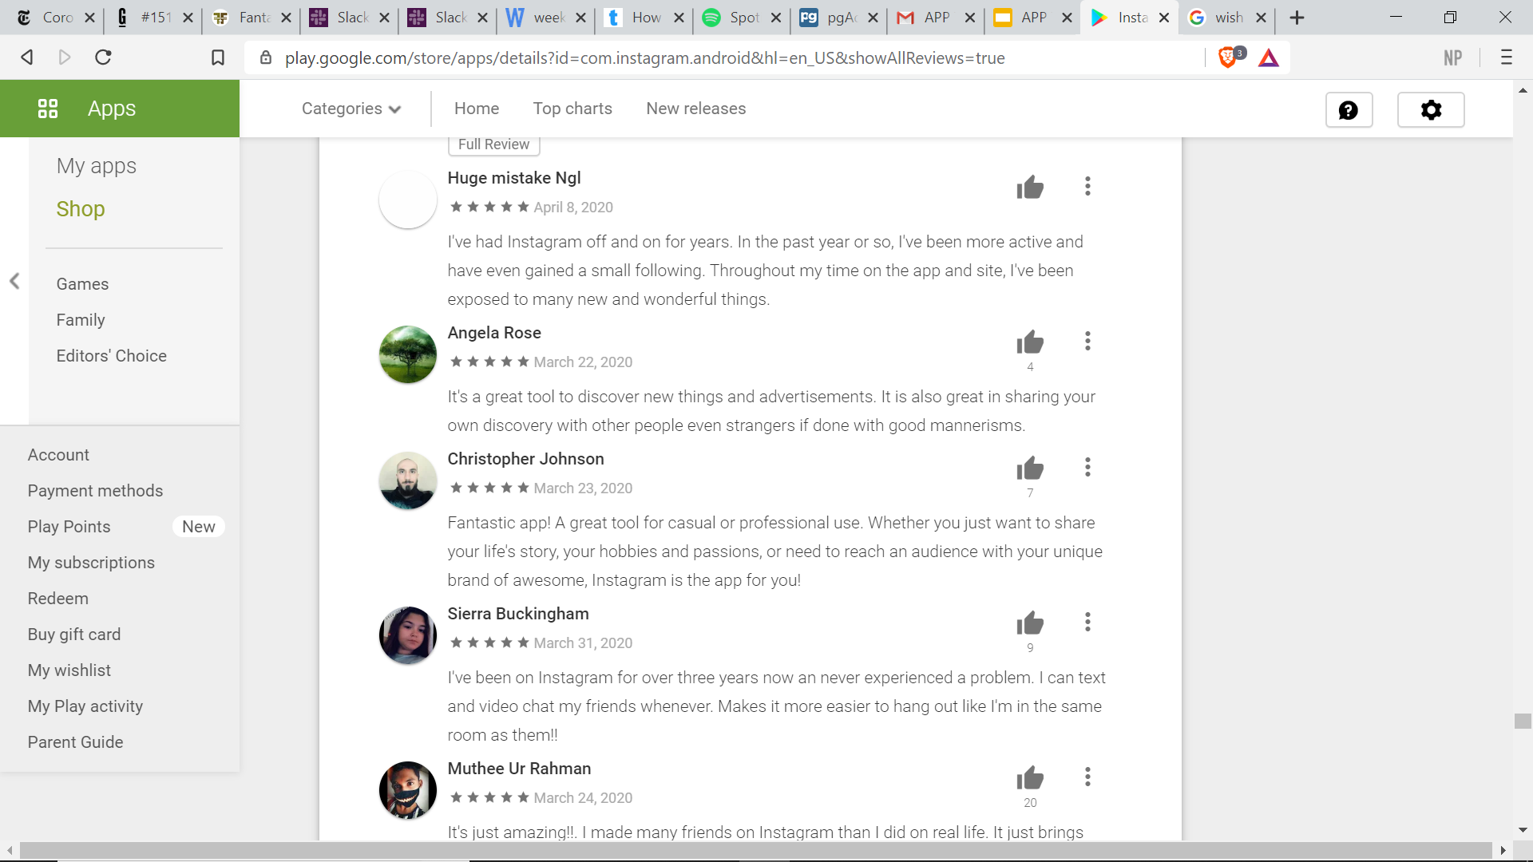
INSTAGRAM

Slide 13
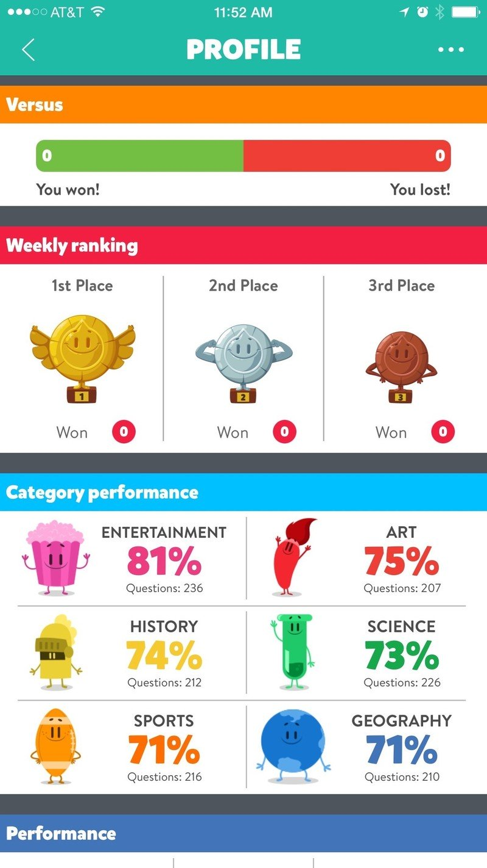
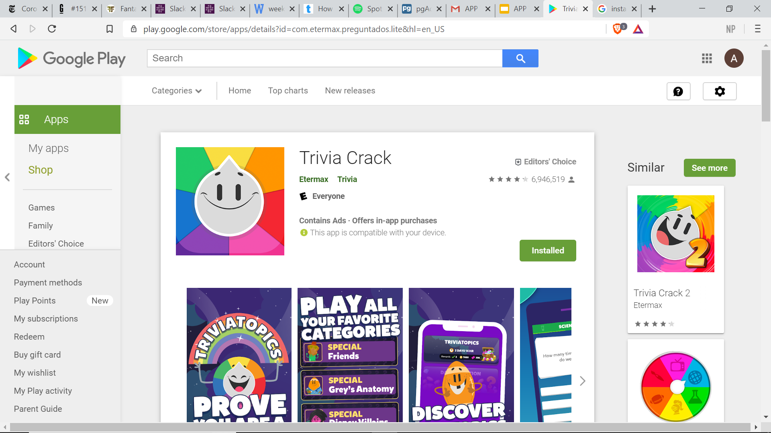
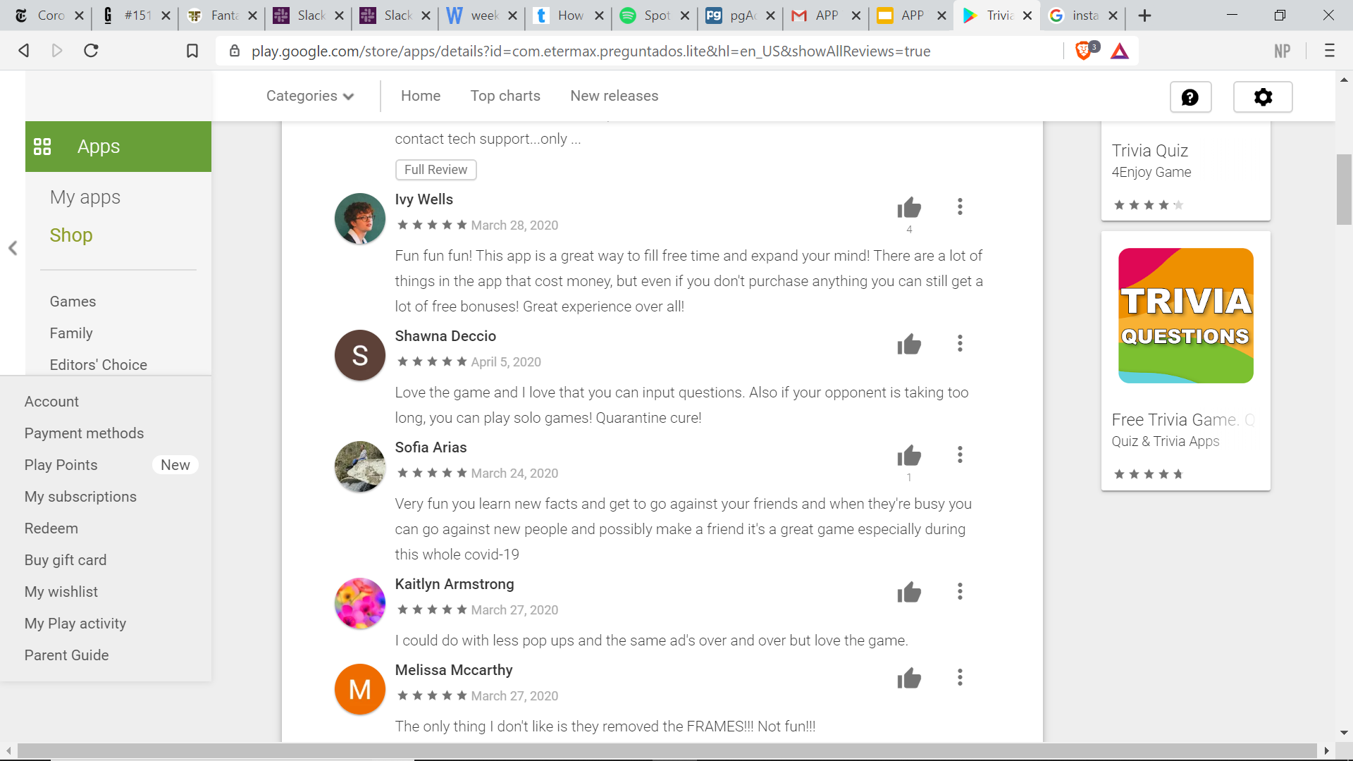
Trivia Crack

Slide 14


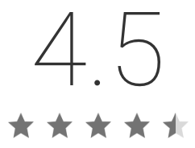
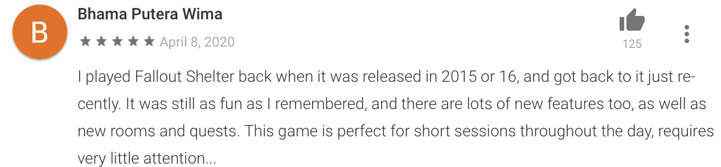
Fallout Shelter

Slide 15

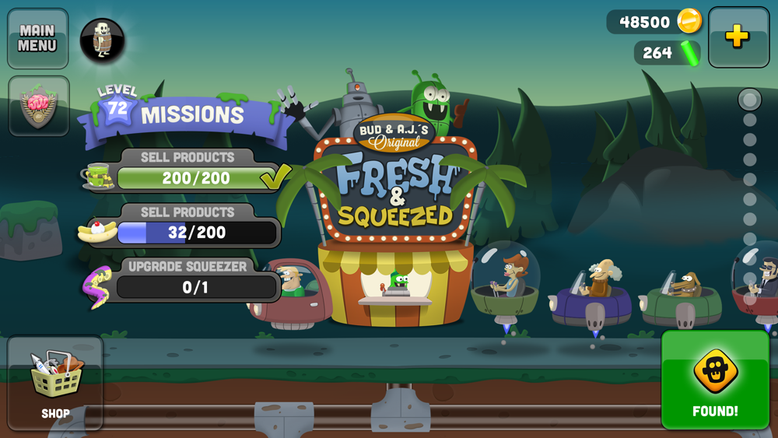
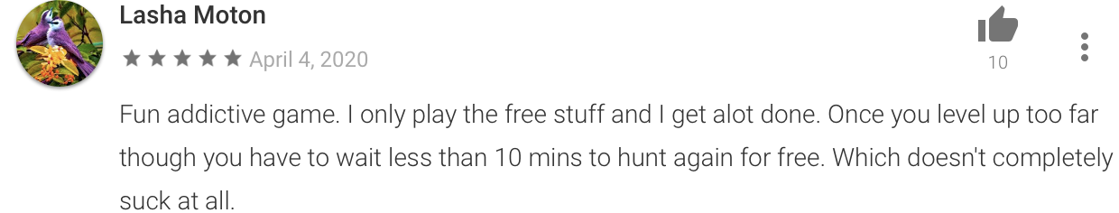
Zombie Catchers

Slide 16

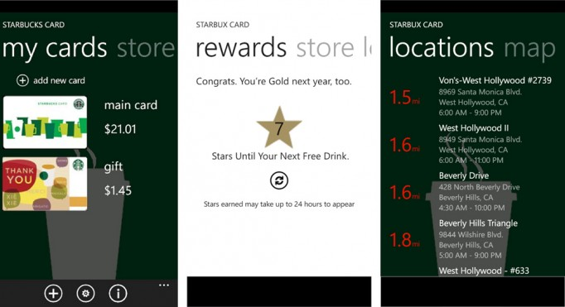
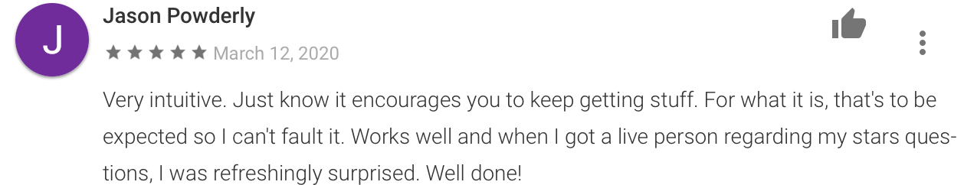
Starbucks
Always keep caffeinated.

Slide 17
Top 3 Genres
1
2
3

Slide 18
Top 3 Genres
By Total Review Count then Highest Review
Just by highest Review

Slide 19
Genre 1
App 1
App 2
App 3

Slide 20
Genre 2
App 1
App 2
App 3

Slide 21
Genre 3
App 1
App 2
App 3

